Slide 1
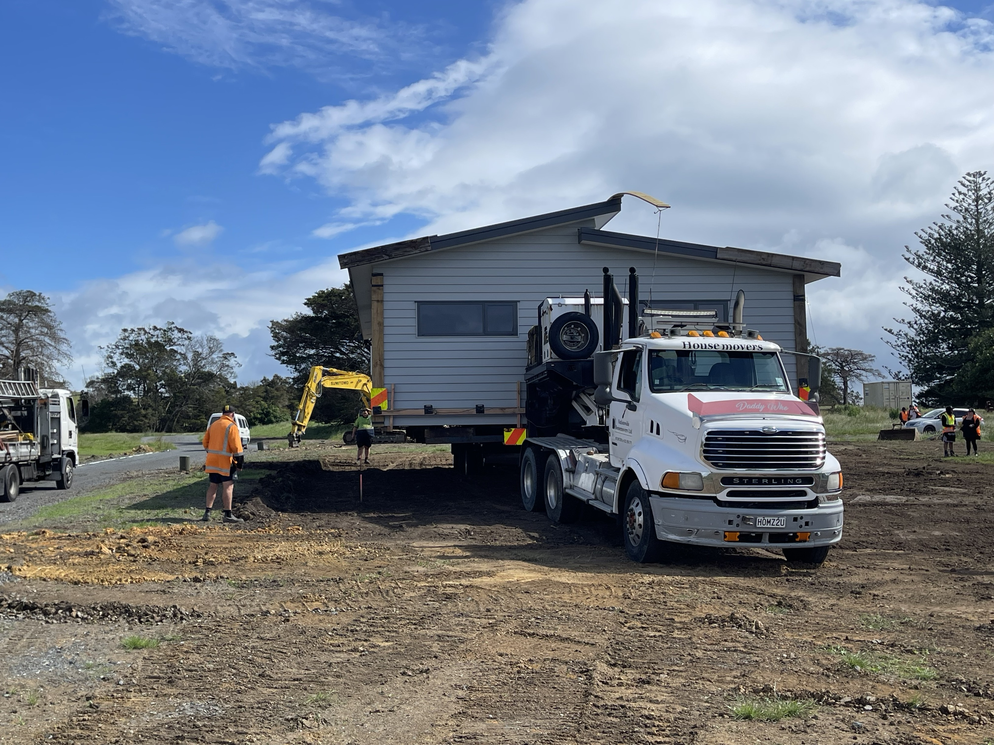
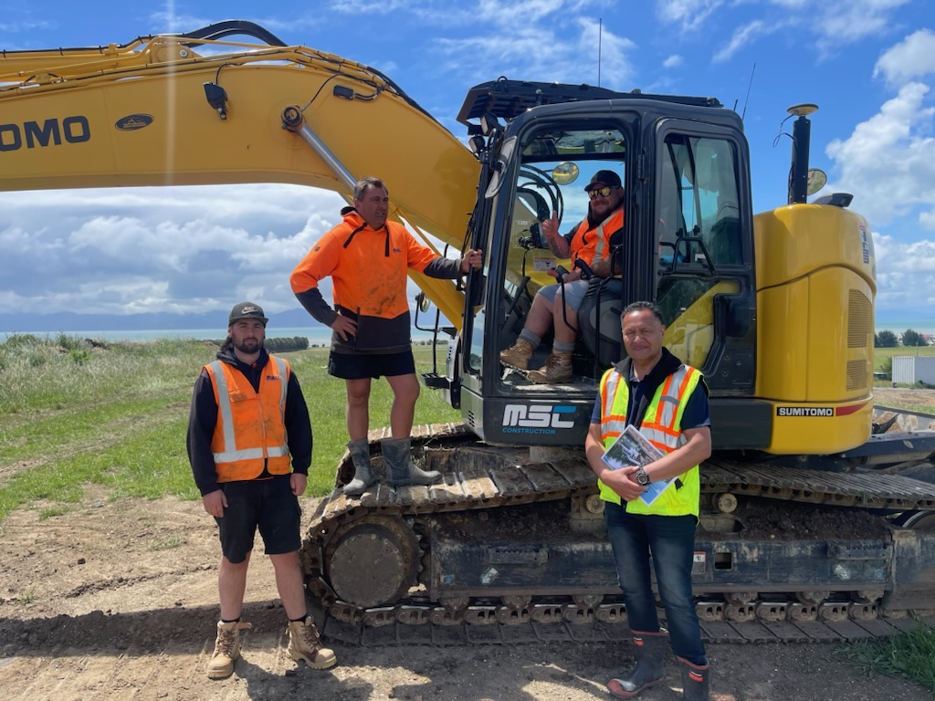
Analysis of District Plan Papakāinga Rules 12 Pipiri/June 2024

Slide 2
Context
Our kaupapa
TPK’s vision is thriving whānau. A key focus area is ensuring whānau have access to affordable, healthy, and secure homes
A priority for our housing policy work is addressing barriers to building on whenua Māori
This will both increase housing supply and tautoko whānau to realise their aspirations for their whenua
Barriers to building on whenua
The key barriers to building homes on whenua Māori have been described (e.g. 2011 Auditor General report):
gaining consent of multiple owners
access to finance
Māori Land Court processes
Local authority consent processes
lack of coordination between agencies

Slide 3
Purpose of report
Purpose of our report:
Provide a snapshot of different district plans across the motu today
Identify examples of good practice
Make suggestions on how local planning rules can be improved in future
Inform government policy development around removing planning barriers
Provide a basis for kōrero with Māori housing sector, councils, planners, agencies
Opportunities to make change:
Inform government initiatives: RMA reform, Going for Housing Growth
Influence councils to adopt more enabling planning provisions in district plans
Build awareness and knowledge of papakāinga and whenua Māori in councils
Limitations:
Narrow focus – we didn’t look at regional council consents, development contributions, plan change processes, Māori Land Court, finance, etc
Desktop research - limited engagement (so far) with whānau, council kaimahi, etc

Slide 4
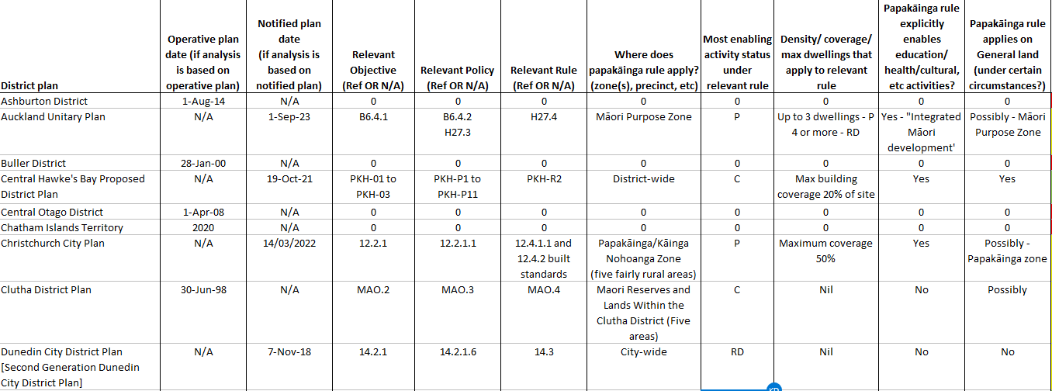
Methodology

Slide 5
Findings (1/2)
More than two thirds of district plans provide for papakāinga in some way
45 out of 65 plans have an explicit papakāinga rule
This should assist whānau who want to develop their whenua
No obvious correlation with amount of whenua in district, age of plan, etc
Definition of ‘papakāinga’ varies between plans
Narrow definitions only refer to residential use/housing
Broad definitions explicitly mention other uses: education, health, cultural, commercial
Papakāinga rules apply to different types of land in different districts
Usually rules apply to Māori freehold land
Sometimes also General land that was compulsory converted, or that is vested in a trust
Most often, papakāinga rules apply within the rural zone or a special purpose zone
Reflects location of whenua blocks
In 17 plans papakāinga is a district-wide activity

Slide 6
Findings (2/2)
Activity status varies between districts (and between zones within districts)
Complexity makes it difficult to make comparisons between plans
In 29 plans, papakāinga is permitted somewhere in the district
Often, planning rules limit how many homes can be built on a site
e.g. setbacks, density and coverage limits, minimum area per dwelling
Rare for these limits to be explicitly based on what is sustainable on the land
References to ‘amenity values’ may prevent development in some cases
Resource Management Review Panel (2020) – subjective and used to prevent development
Papakāinga development plans may support the process
Require information on location of house sites, other structures, potential future uses, etc
These may help support good planning and design processes

Slide 7
Conclusions
Better planning rules can help unlock the housing potential of Māori land:
District plans need papakāinga rules – not just high-level statements in objectives
Rules should apply in all the places where hapori Māori may want to develop papakāinga – inlcuding General land and urban areas, for example
Papakāinga rules should not simply mirror subdivision rules
Planning rules should be supported by related policies on development contributions, rating, etc
Strong local relationships are essential to developing planning provisions that are effective in realising the potential of whenua
Next steps:
Further kōrero with interested parties to gain deeper understanding of issues and best practice:
Feedback from whānau and papakāinga developers
Feedback from councils
How can we improve the system to enable more papakāinga? What is central govt’s role?
Build a work programme to deliver those improvements
N.B. Papakāinga research (later in 2024) will capture experience of whānau/trustees

