Slide 1
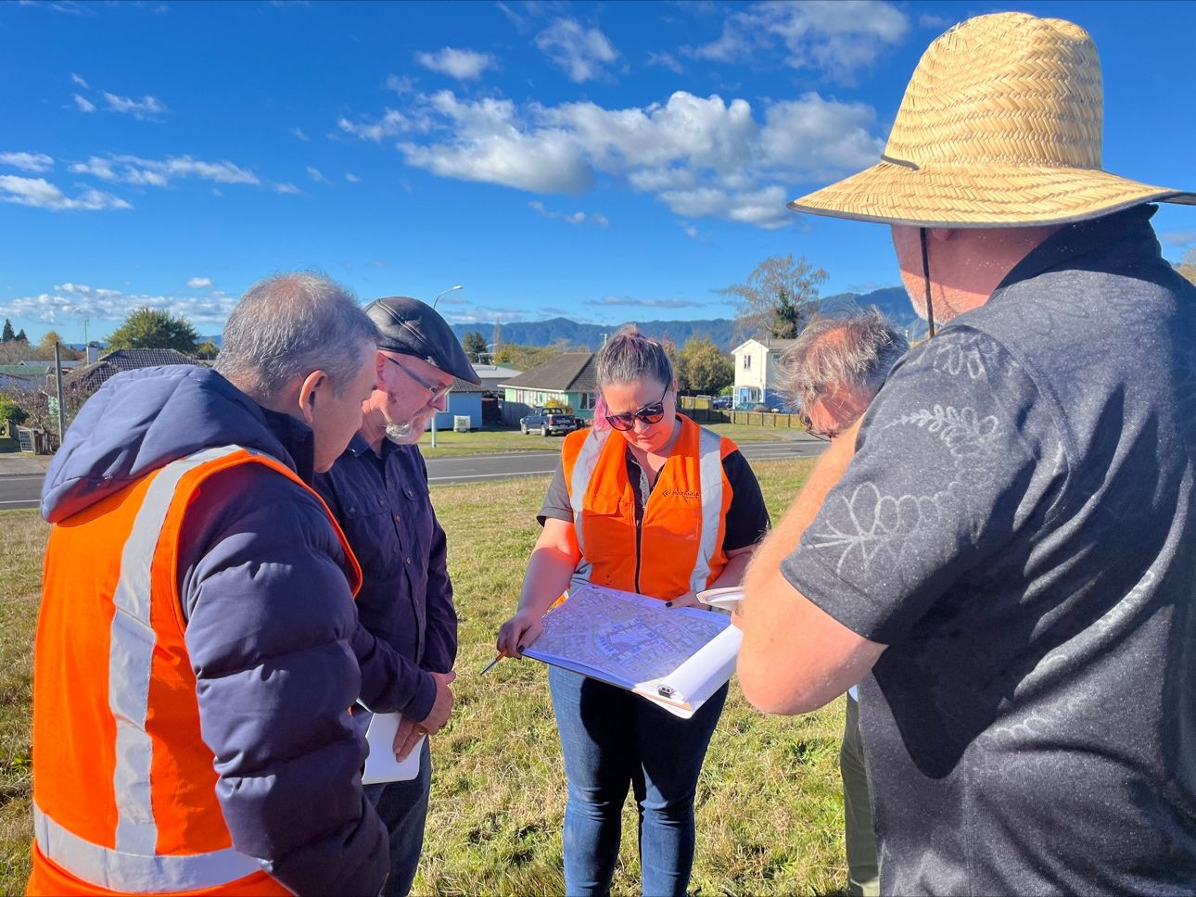
District Plans and Papakāinga
Presented by
Paul Sheeran and Shalom Haenga

Slide 2
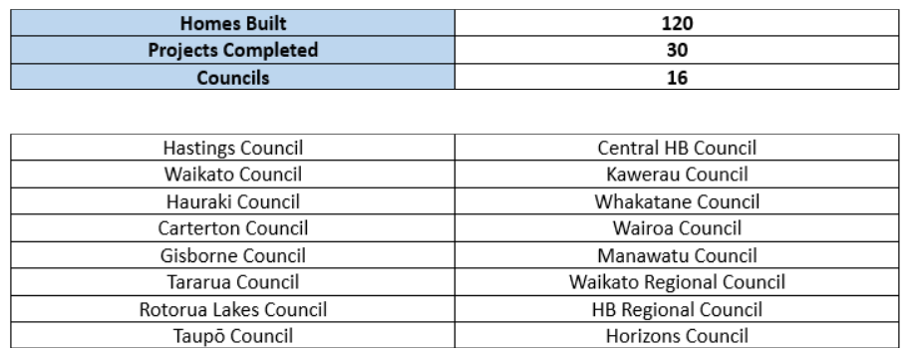
District Plans and Papakāinga
Presented by Paul Sheeran

Slide 3
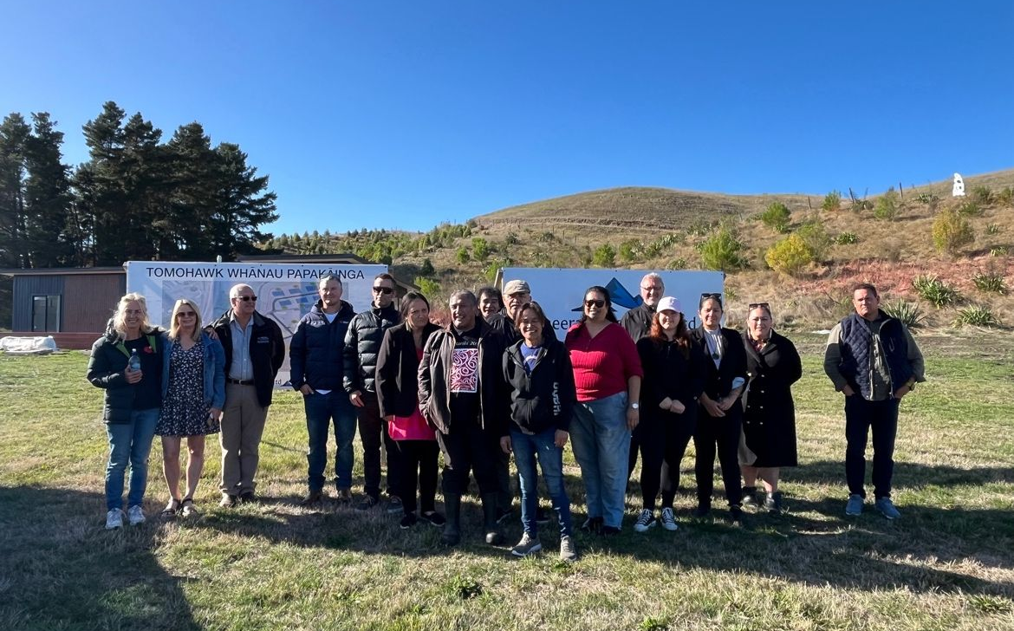
What is an enabling District Plan for papakāinga?
Having a specific section in the District Plan for papakāinga
District Plans that are enabling for rural/Māori whenua

Slide 4
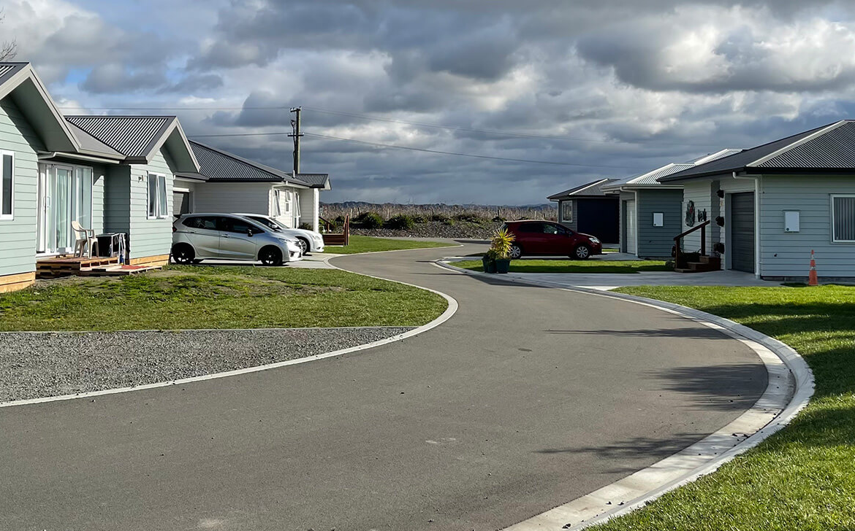
Why is HDC District Plan enabling for papakāinga?
HDC’s District Plan enables whānau to build as many homes as they can service relative to infrastructure systems.

Slide 5
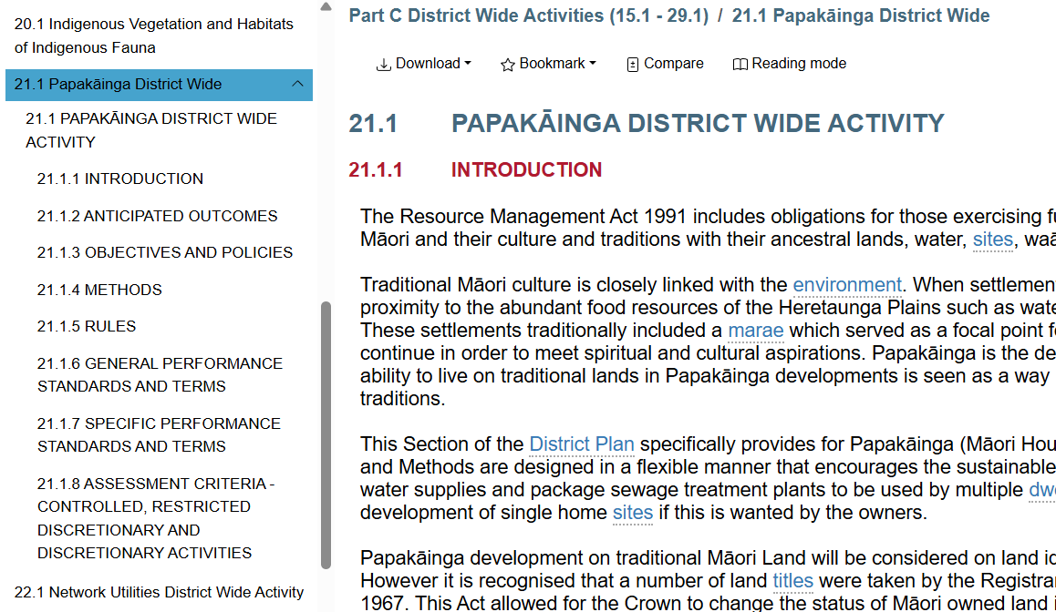
HDC District Plan
Has a specific papakāinga section in the District Plan.
Provides a process for whānau to follow.
The District Plan is enabling for rural/Māori whenua

Slide 6
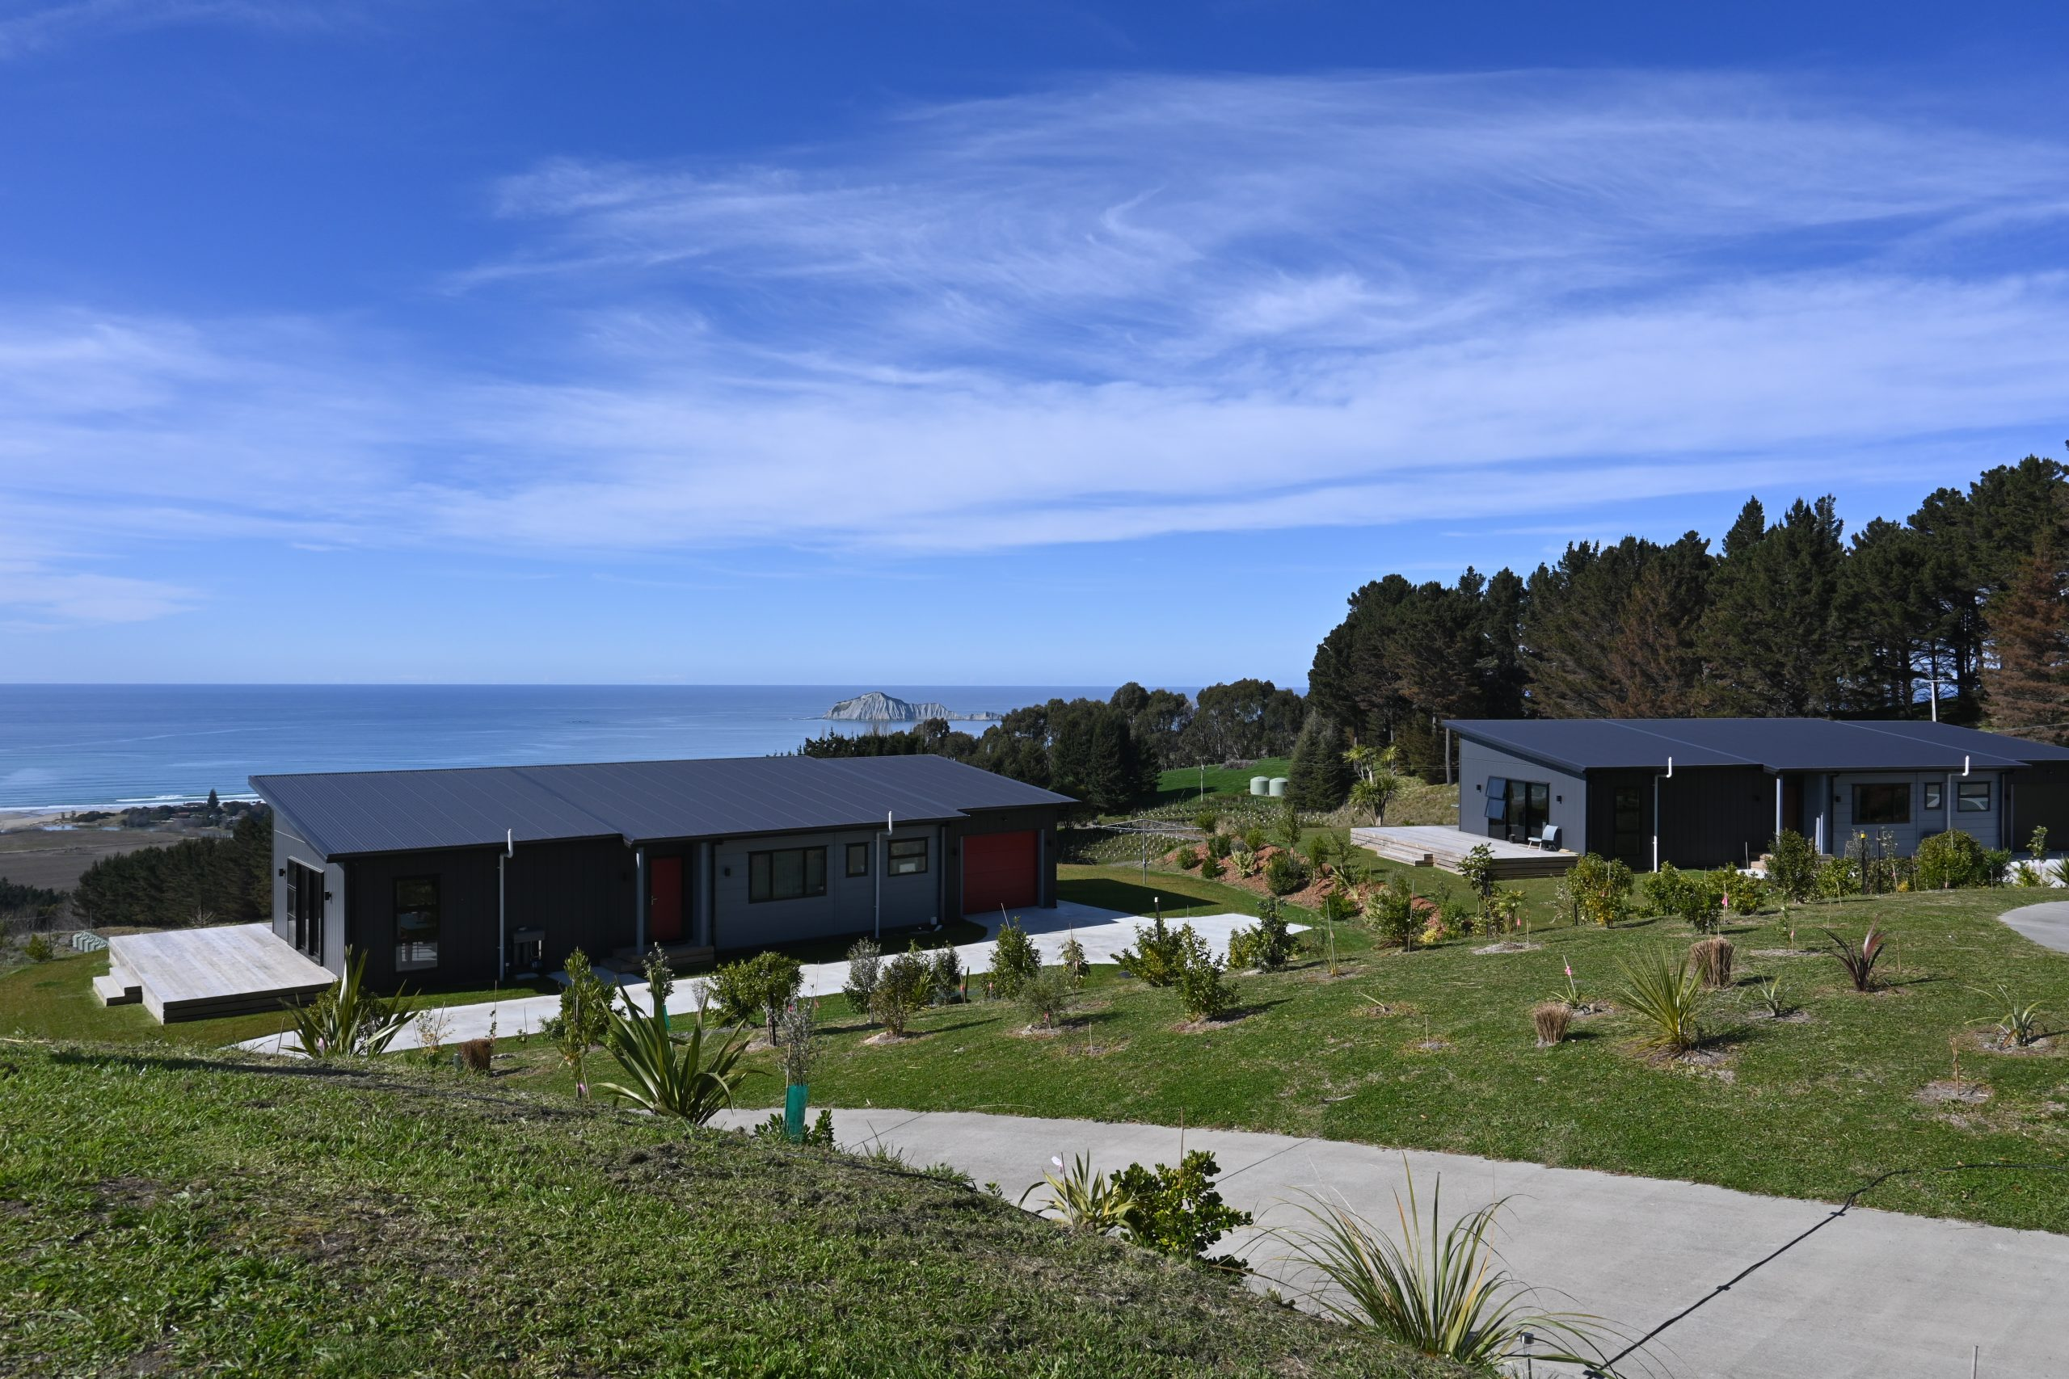
Tiakitai Papakāinga
Council waterpipe went through whenua where new homes were to be sited.
Pipe was installed without consult or consent.
Solution – redirected outside of the papakāinga boundary along the road reserve but still had to be linked back across the whānau whenua and reconnected back into itself.

Slide 7
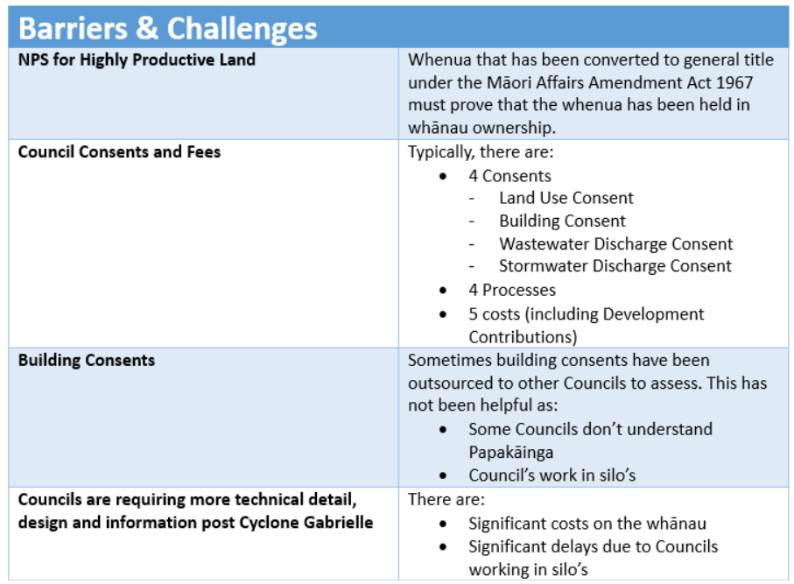
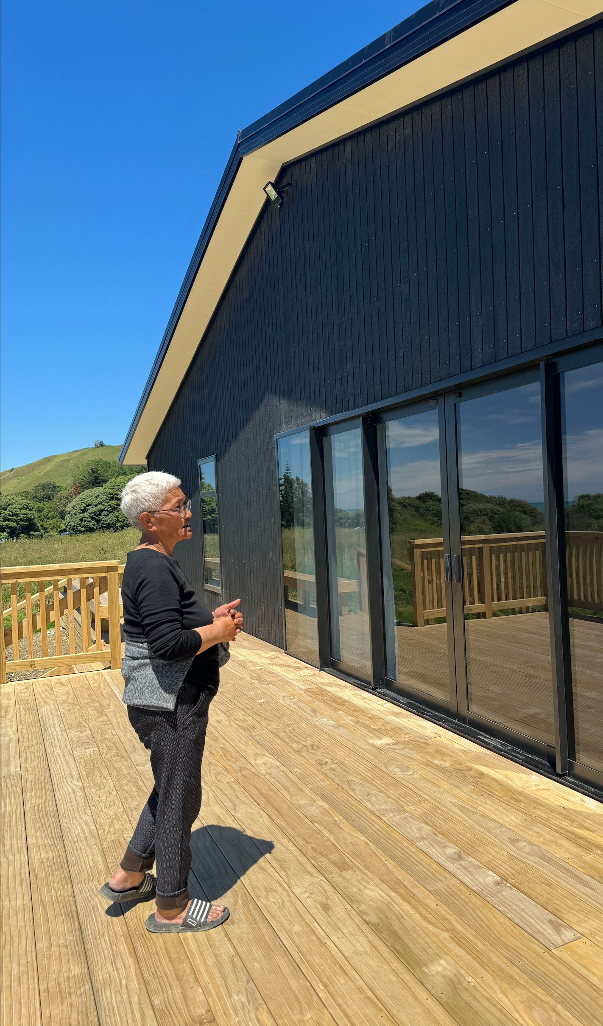
District Plans and Papakāinga
Presented by Paul Sheeran

Slide 8
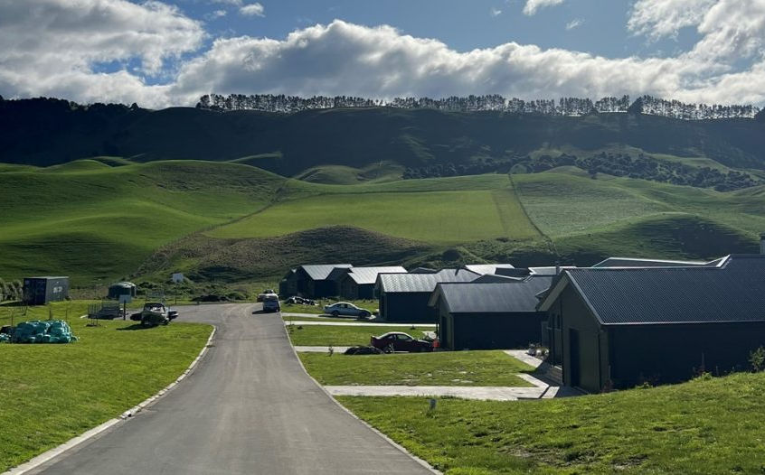
What will be helpful?
Pre-application hui with Council
A joined-up approach between Councils would provide a better streamlined process and experience for whānau, and hopefully Council too. This would also mitigate the ‘ping-pong’ effect for whānau between Councils.
Streamlined processes internally within Councils i.e. WW/SW Engineers, Transport & Roading, Land Use and BC teams.
Having a section in the District Plan for papakāinga provides guidance and a process that can be followed.

Slide 9
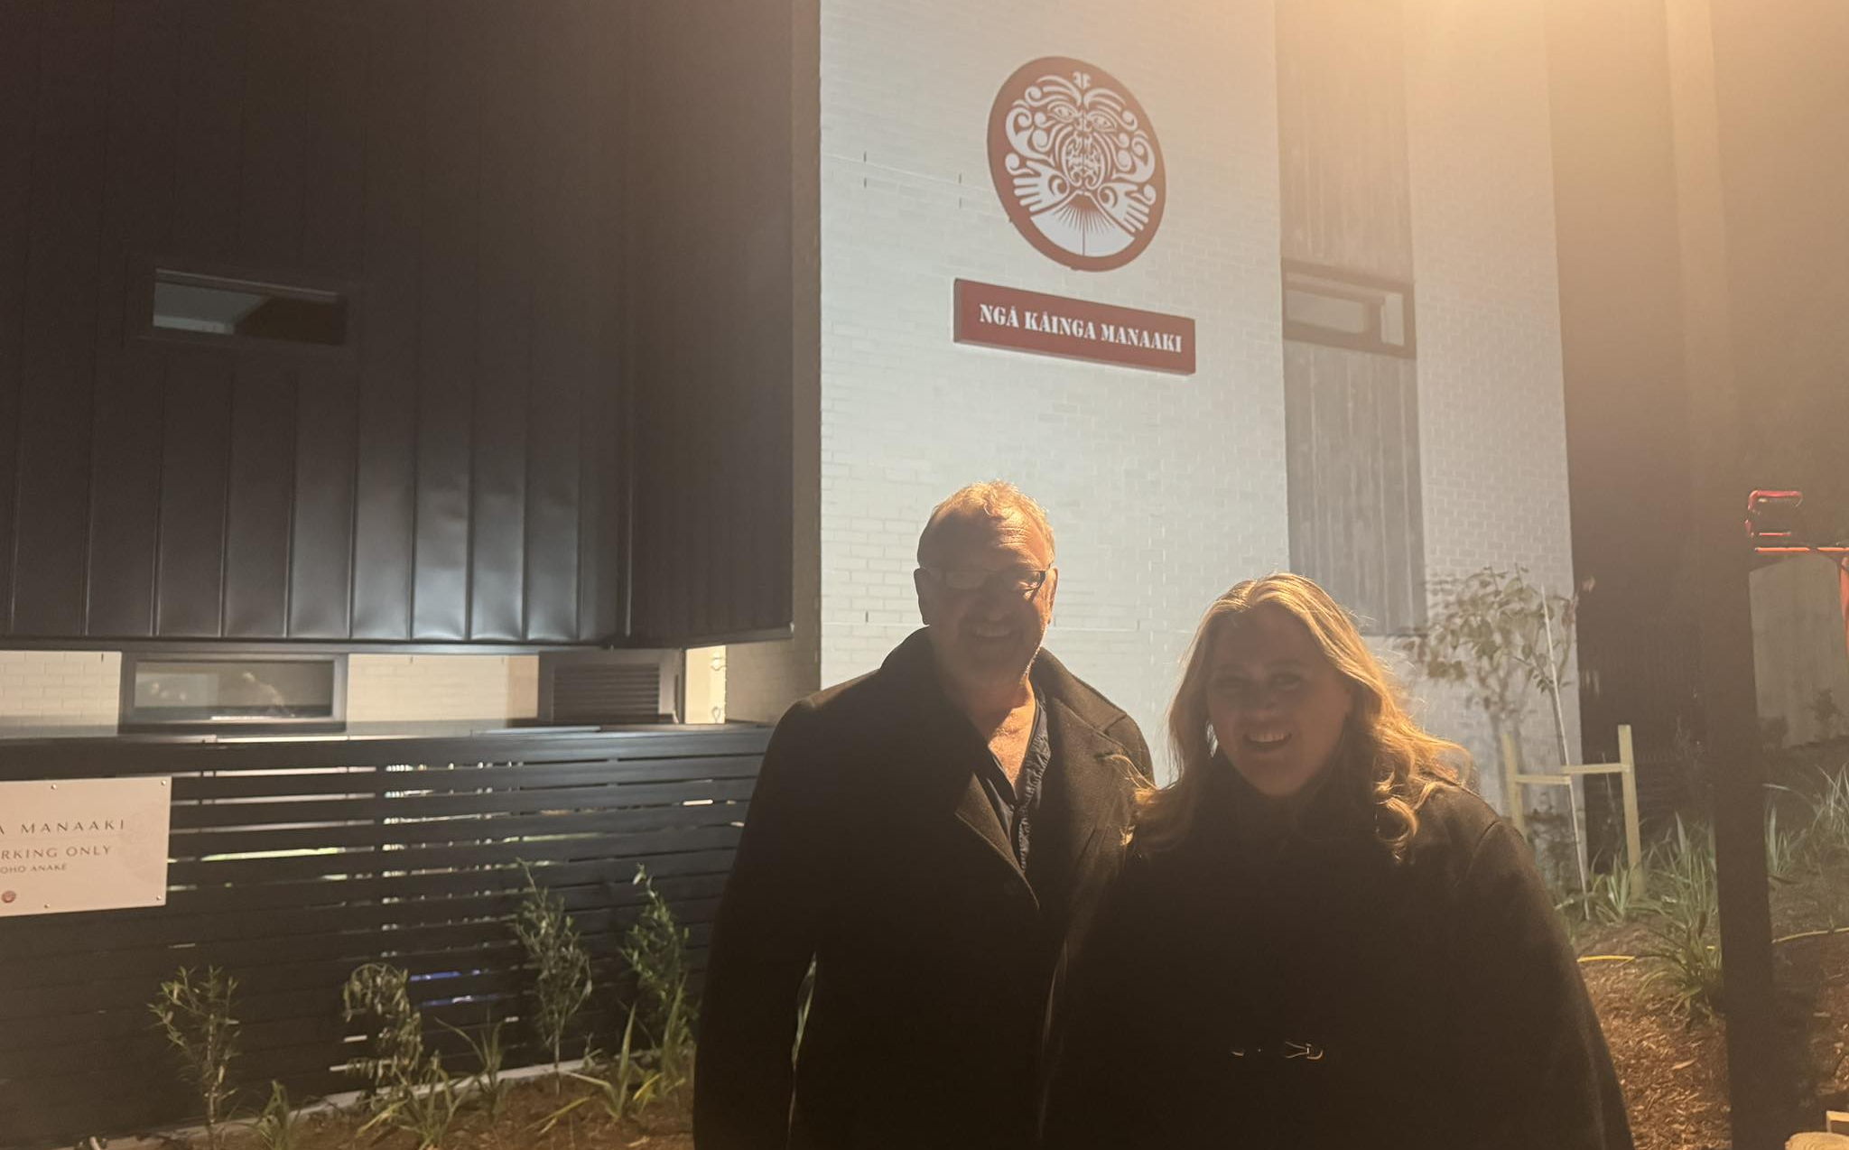
CONTACTS
Paul Sheeran (CEO)
027-575-2266
Paul@saltd.co.nz
Shalom Haenga (Project Manager)
027-395-0069
Shalom@saltd.co.nz
WEBSITE:
https://www.sheeranassociatesltd.com

