Slide 1

Planning Rules and Implementation
Papakāinga Housing within Hastings District

Slide 2
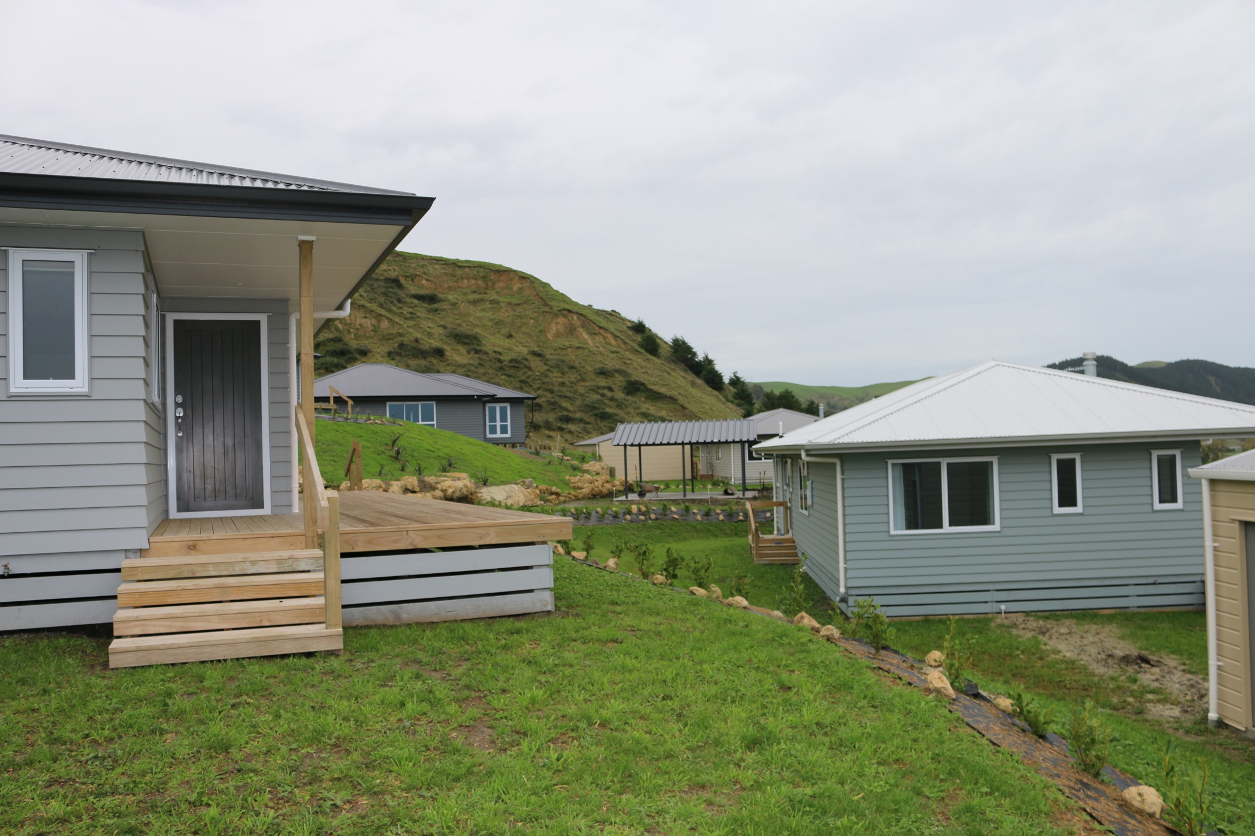
Background
Papakāinga introduced into Hastings District Plan in 2003.
Joint Agency group of Hastings District Council, Te Puni Kōkiri and Māori Land Court formed in 2007. Creation of the Papakainga Development Guide.
Formed due to the lack of papakāinga developments within the District
Further work undertaken to improve the District Plan in 2015 to provide greater encouragement and ease for papakāinga within the District
Provided excellent working relationships between the agencies so that applicants for papakāinga had clear processes to follow

Slide 3
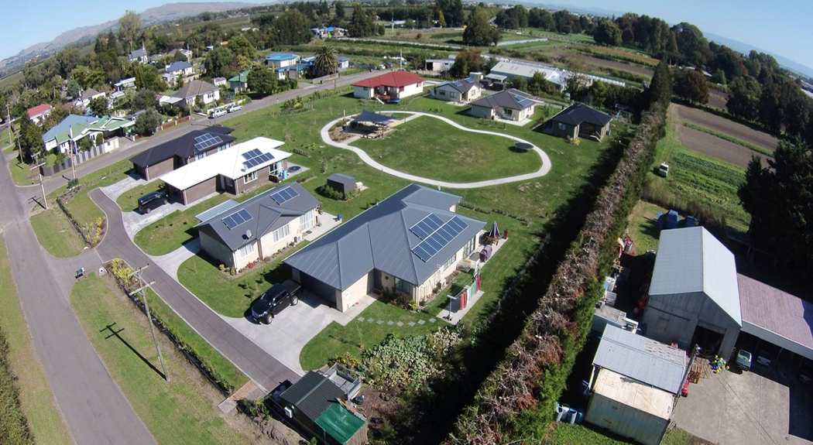
Limitations
District Plan is not the magic bullet, simply enables
Still need project management to ensuring the consent, land ownership, grants, kainga whenua loans and multiple other aspects are managed
Need to reduce road blocks where possible

Slide 4
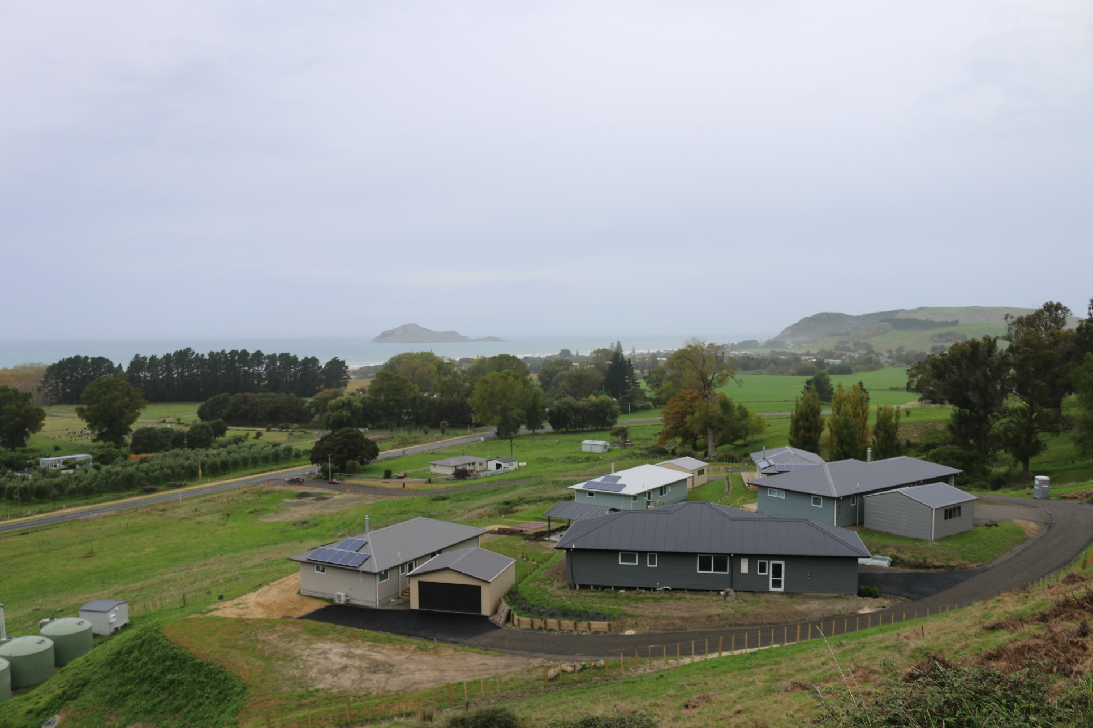
Consenting
Papakāinga is a District Wide Activity
Controlled Activity if standards met.
Mainly on Māori Title, but some opportunities for papakāinga on General Title
Most developments are small scale, 2 – 8 dwellings, but have had numerous applications
Allows for additional cottage industry and commercial

Slide 5
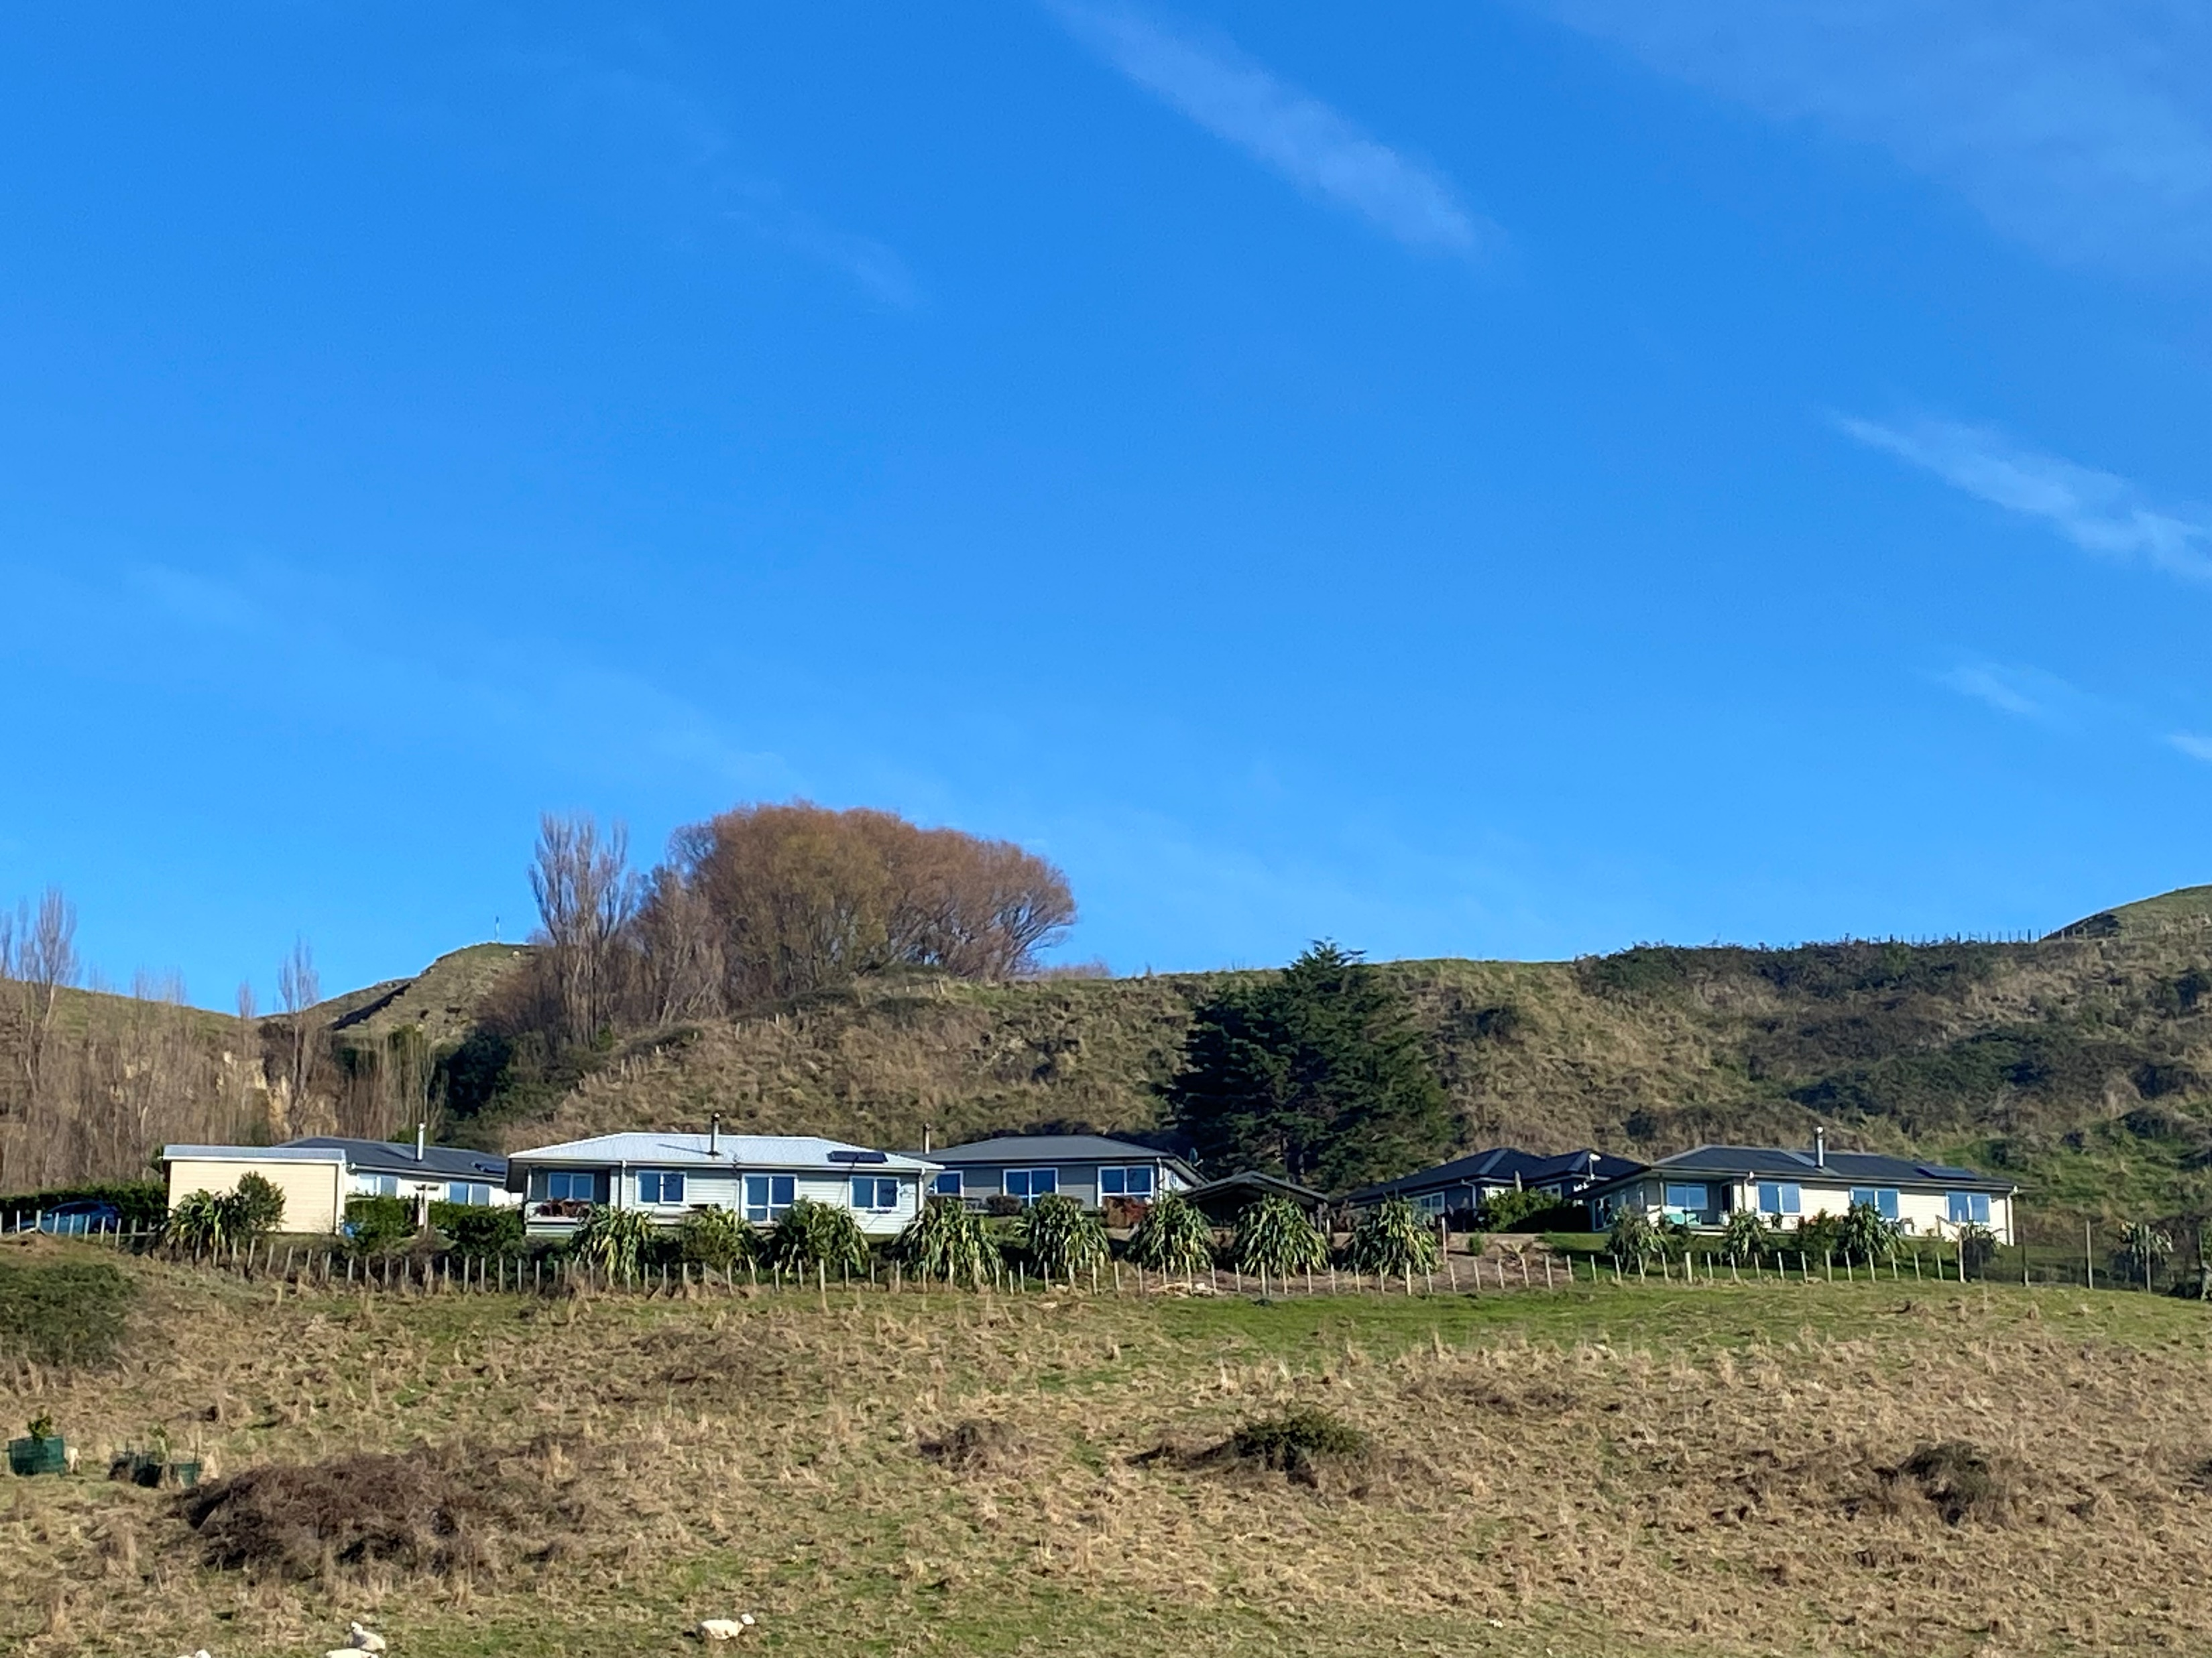
Consent Numbers
Prior to Papakāinga Chapter in District Plan
9 consents
After Papakāinga Chapter was introduced
35 consents

Slide 6
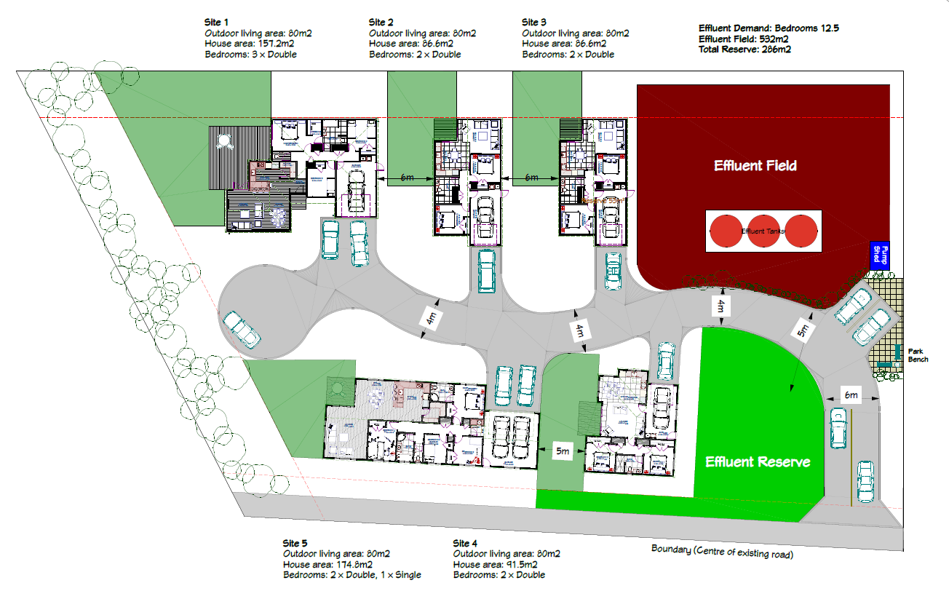
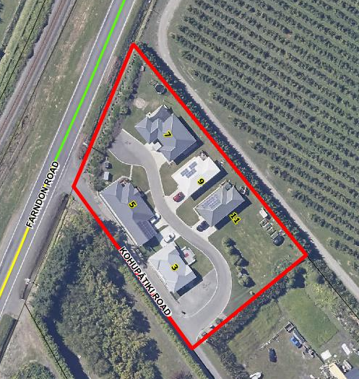
Papakāinga
Examples

Slide 7
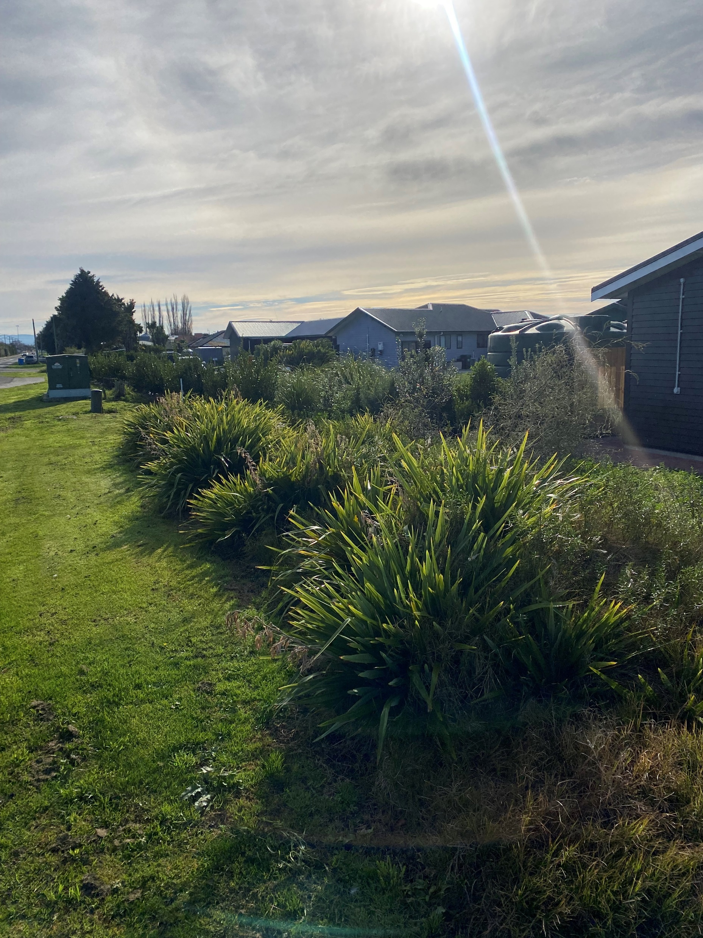
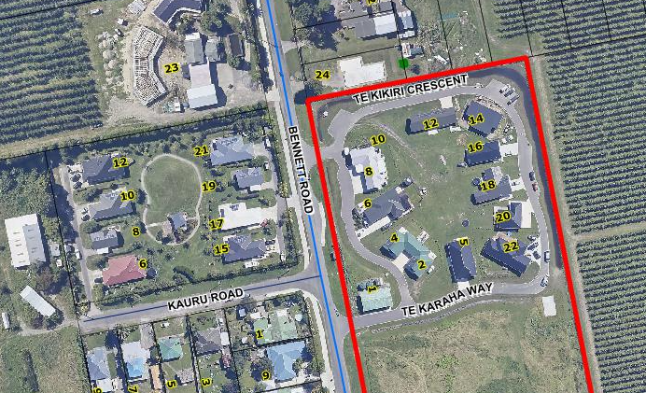
Papakāinga
Examples

Slide 8
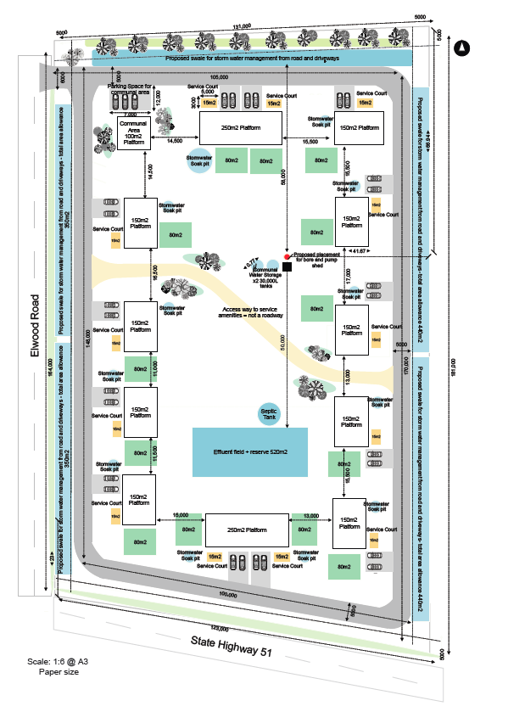
Papakāinga
Examples
13 dwelling papakāianga
Urban edge
Declared general land under the Māori Affairs Amendment Act 1967 in 1972
Remained in whanau ownership
Covenant to ensure continued administration and ownership
Discretionary activity due to earthworks

Slide 9
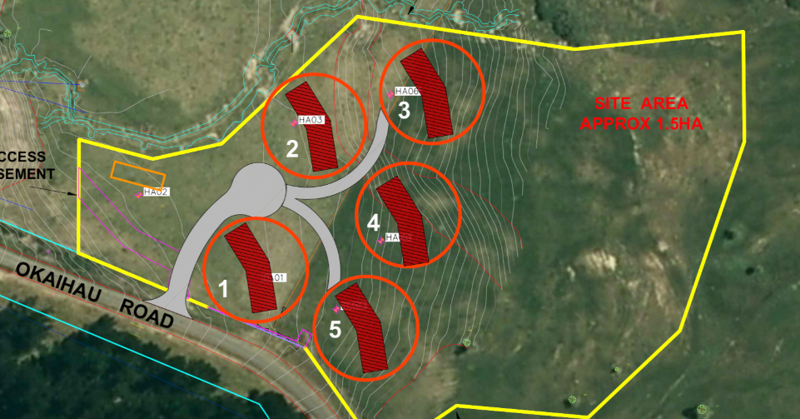
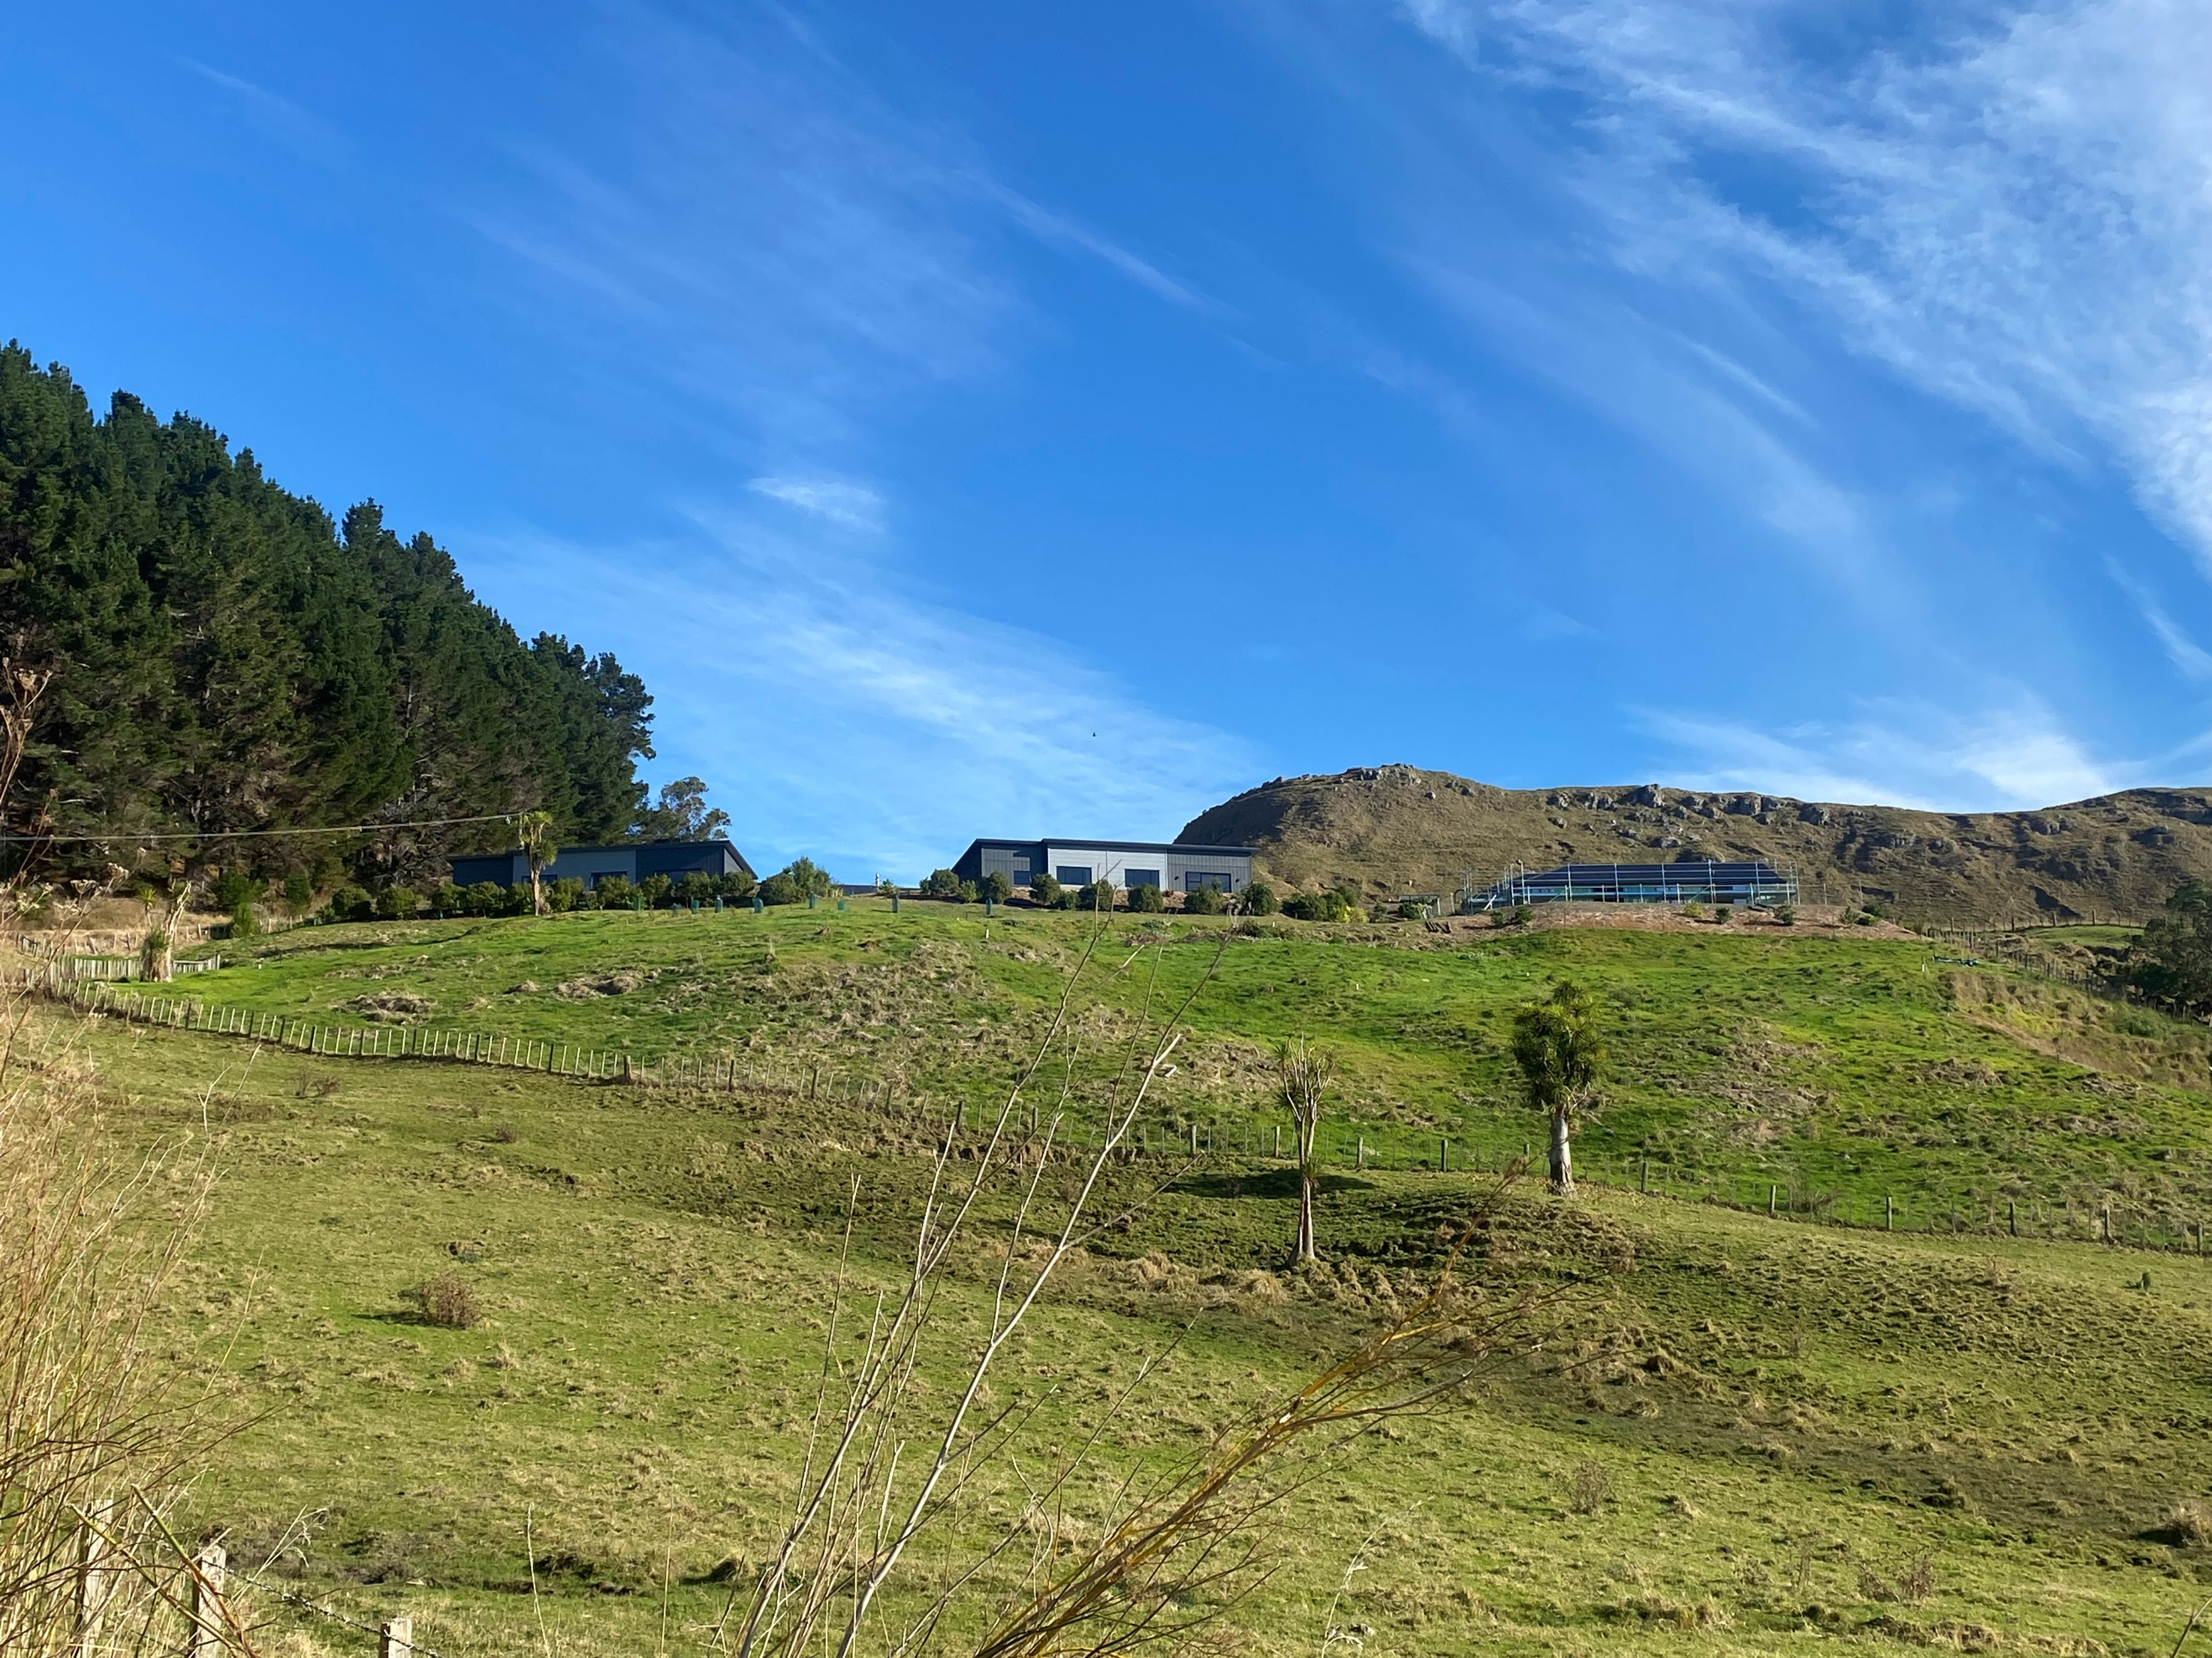
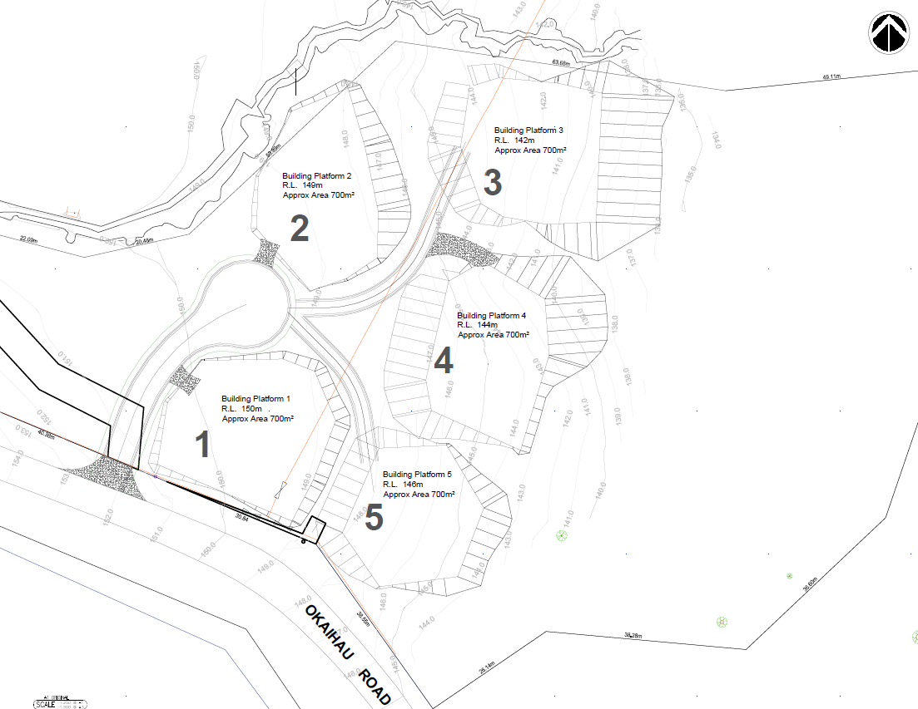
Papakāinga
Example

